Slide 1
Cultural Matching
Race, Color and Discrimination

Slide 2
Introduction
Cultural matching encompass race, color and discrimination.
Jobs in the U.S. are governed by race and color (Michael, 2009).
Africa-Americans suffer the most compared to Native Whites.
Rates of unemployment have continued to rise.
Notes:
Elements of discrimination have been evident in finding jobs, and as such, aspects such as color and race exist in the context of education (Michael, 2009). Hence, there is the need to accept cultural diversity in our communities.

Slide 3

The Aspect of Skin
African-Americans change their names abbreviations in interviews.
Blacks have removed their bachelor’s degrees from education institutions related to blacks historically (Michael, 2009).
Education has widened the gap between the Whites and Blacks.
Educated blacks suffer disproportionately while finding jobs.
Notes:
African-American have been unable to get jobs in the United States since they are never called back for interviews simply because of the skin color. Most of employment opportunities tend to benefit the Whites in expense of the blacks in the United States (Michael, 2009).

Slide 4
The Aspect of Discrimination
Discrimination is complemented by high incarceration rates for the blacks.
Elements of discrimination are evident in the salary schemes.
Americans are guaranteed of $7500 while black Americans enjoys less than $17, 500 (Abigail, 2014).
Discrimination continues to widen the gap between blacks and whites.
Notes:
Discrimination in the United States is complemented by very high incarceration rates for the blacks as well as lack of inherited wealth as a result of long periods of discrimination for the case of African American’s (Abigail, 2014). In this case, elements of discrimination are evident in the salary schemes.

Slide 5
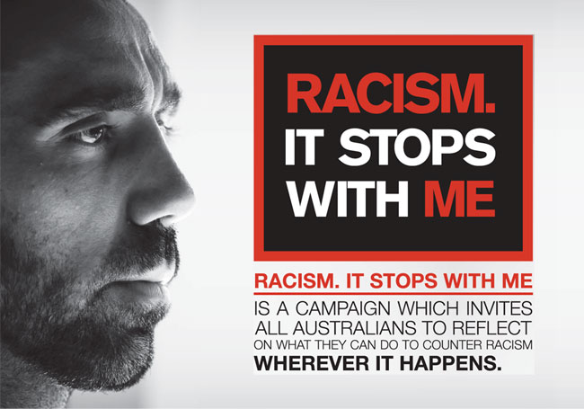
The Aspect of Color
Jobs in the United States are based on the aspect of race.
Provision of jobs based on color has resulted to severe unemployment rates.
African-American face 16.6% unemployment rates (Abigail, 2014).
Whites face 7.1% at the age bracket of 18 to 34 years old.
Notes:
According to Abigail (2014), African-American individuals who hold an Associate’s Degree has the same chances of attaining a good job as White males who only have a high school diploma. Hence, color is seen as a sensitive factor that is likely to trigger the increase of unemployment rates in the United States.

Slide 6
Conclusion
Unemployment opportunities have increased as a result of race, color and discrimination aspects.
African-American have been stigmatized in job interviews.
There is need to embrace cultural diversity.
Affirmative actions and supporting African-American based institutions is vital.
Notes:
It is critical to consider more investment in community college and in institutions that support education for American-Americans to encourage diversity. As such, it is vital to consider raising awareness of the need to embrace all races in the same way.

Slide 7
References
Abigail, B. (2014). A Black College Student Has The Same Chances Of Getting A Job As A White High School Dropout. Think Progress. Retrieved from https://thinkprogress.org/a-black-college-student-has-the-same-chances-of-getting-a-job-as-a-white-high-school-dropout-b7639607fdf1/.
Michael, L. (2009). Whitening the Resume. The New York Times. Retrieved from https://www.nytimes.com/2009/12/06/weekinreview/06Luo.html.

